Slide 1






Introduction to ASP.NET
Presented By :
Muhammad Atif Hussain
Head of I.T. (Takaful Pakistan Limited)
Technologies Consultant (AUC Technologies)
MCS(KU)
MSCS(SZABIST)
MCP
MCAD
MCSD
MCTS (Windows, Web, Distributed Applications)
MCPD (Enterprise Applications)
MCT(Microsoft Certified Trainer)

Slide 2
ASP.NET
Introduction
ASP .NET
  Platform
  Page development
  “Baked-in” application services
  Run time
05.<number>
Notes:
Module 05: Building ASP .NET Applications
Module 05.<number>
Copyright Microsoft 2001
July 15, 2001
Module 05 Agenda
What you will learn:
How you develop Web Applications and pages using ASP .NET
The Baked-in services provided by the ASP .NET Common Language Runtime
How easy it is to deploy your new Web Applications

Slide 3
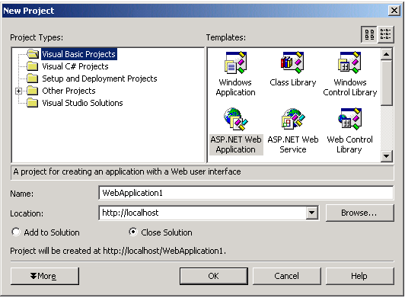
Introduction
ASP .NET and Visual Studio® .NET are designed for Web Applications
Designer for Web Applications and XML Web services
Drag and drop for controls and HTML features
Rich language integration
05.<number>
Notes:
Module 05: Building ASP .NET Applications
Module 05.<number>
Copyright Microsoft 2001
July 15, 2001
Introduction
Active Server Pages .NET
Active Server Pages .NET, ASP .NET, (formerly referred to as ASP+) is more than simply the next version of ASP. It is a unified Web development platform that enables developers to build enterprise-class Web Applications. While ASP .NET is largely syntax-compatible with ASP, it provides a new programming model and infrastructure that enables a powerful class of applications. You can augment your existing ASP applications by incrementally adding ASP .NET functionality.
ASP .NET provides a rich development environment that features drag and drop development and a powerful event driven architecture. It is a powerful upgrade to ASP and Web development in general that exists within the .NET Framework.
ASP .NET is a compiled .NET Framework-based environment where you can author applications in any .NET Framework compatible language including Visual Basic®, C# and JScript. Additionally, the .NET Framework platform is available to any ASP .NET application. Developers easily can access the benefits of the .NET Framework, which include a fully managed, protected and feature-rich application execution environment and simplified development and deployment as well as seamless integration with a variety of languages.
You can write your ASP .NET applications in Notepad if you like, but it’s easier to use Visual Studio .NET with its powerful GUI interface and rich set of tools for developing ASP .NET applications. The features that were included in Visual InterDev in the past are an addition of Visual Studio .NET.

Slide 4
Introduction..
Builds on the programming classes of the .NET Framework
Controls and infrastructure simplify the building of Web Applications
05.<number>
Notes:
Module 05: Building ASP .NET Applications
Module 05.<number>
Copyright Microsoft 2001
July 15, 2001
Introduction
ASP .NET
ASP .NET builds on the programming classes of the .NET Framework, providing a Web Application model with a set of controls and infrastructure that make it simple to build Web Applications. It also includes controls that encapsulate common HTML user-interface elements such as text boxes and drop-down menus. These controls run on the server, however, and push their user interface as HTML to the browser.
On the server, the controls expose an object-oriented programming model that brings the richness of object-oriented programming to the developer. ASP .NET also provides infrastructure services, such as session state management and process recycling, that further reduce the amount of code a developer must write and increase application reliability. In addition, ASP .NET uses these concepts to enable developers to deliver software as a service. Using Web services features, ASP .NET developers can write their business logic and use the ASP .NET infrastructure to deliver that service via SOAP.
The resulting HTML from ASP .NET applications is browser neutral, providing a rich architecture for developing HTML 3.2 and higher applications. For instance, the page shown on this slide is using ASP .NET server controls that are rendering standard HTML to the browser.

Slide 5
Overview
Originally Active Server Pages (ASP)
ASP.NET
  Successor of ASP
  Different paradigm (.NET Framework)
Topics
  Stateless web paradigm
  Code behind pages
  Response and Request objects
  Session and Application variables

Slide 6
Stateless web paradigm
Client may return to any page at any time in any state
State information is posted during each page request (?xxxxx=xxxxx)
ASP.NET web controls automatically repost their own state to maintain the ViewState of the page

Slide 7
Code behind pages
Binds HTML page to a code file written in a .NET language
HTML page is encapsulated in a System.Web.UI.Page class
  Events such as Page_Load may be handled
All ASP.NET controls can be used as regular .NET objects
Scripts in HTML page may call code behind functions
Everything will eventually end up as HTML

Slide 8
Response and Request objects
Response
  Represents the client browser
  Response.Redirect(http://www.microsoft.com)
  Response.Cookies[“UserName”] = “Bob”
Request
  Represents the server
  Request.PhysicalApplicationPath
  UserName = (String)Request.Cookies[“UserName”]

Slide 9
Page Development Topics
Separation of Code from Content
Dynamic Compilation
Server Controls
Validation
Custom Controls
Page Event Life Cycle
05.<number>
Notes:
Module 05: Building ASP .NET Applications
Module 05.<number>
Copyright Microsoft 2001
July 15, 2001
Page Development Topics
The following slides discuss how to build Web pages using the new ASP .NET architecture.

Slide 10
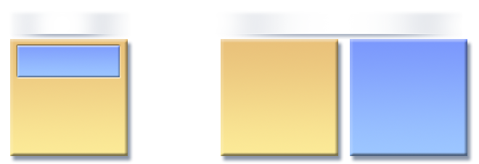
Page Development Topics
Separation of Code from Content
  Developers and designers can work independently
ASP
ASP .NET
Single file
Separate files
code
<tags>
<tags>
code
Form1.asp
Form1.aspx
Form1.vb
05.<number>
Notes:
Module 05: Building ASP .NET Applications
Module 05.<number>
Copyright Microsoft 2001
July 15, 2001
Page Development
Separation of Code from Content
In an ASP page, declarative tags (HTML, ASP directives, server controls and static text) are combined with the code. ASP allows you to perform some code separation, but it is difficult to cleanly separate code from the tags.
In ASP .NET, your code either can be stored on the same page as the tags or on a separate page known as the code behind page. This code separation allows applications to be cleanly structured and to perform much faster than the traditional ASP.
This slide shows that code can be separated into either single pages or separate pages (code and tags).

Slide 11
Server Controls
Server-programmable objects
  Properties, method and events
Encapsulate behavior
Browser-neutral - Can render differently to support multiple browsers or other Web clients
You can create custom server controls
05.<number>
Notes:
Module 05: Building ASP .NET Applications
Module 05.<number>
Copyright Microsoft 2001
July 15, 2001
Page Development
Server Controls
ASP .NET server controls are components that run on the server and encapsulate user interface and other related functionality. They are used in ASP .NET pages and in ASP .NET code-behind classes. This section contains background information and examples to help you develop your own ASP .NET server controls.
Note: The terms ASP .NET page and Web Forms page are synonymous and are used interchangeably in the documentation.
The server controls are programmable in that they provide properties, methods and events for use in your applications. The controls are programmable in your server code, allowing you to interact with those controls and their data. For instance, a button server control may provide code that accesses the properties in the text boxes on a page. Your code only needs to interact with the controls properties to access this data.
For instance, to access a text box you could use this code:
MyName = txtMyName.Text
Many of the controls are databound so you can quickly link data to a control. For instance, the DataGrid can be bound to both ADO .NET data and other data such as XML data.
Specific Internet Explorer 5.5 WebControls
Microsoft provides a set of server controls for IE 5.5 and higher. The Microsoft® Internet Explorer WebControls are a powerful collection of ASP .NET server controls. The WebControls implement a single-source authoring solution for four popular user-interface (UI) elements: MultiPage, TabStrip, Toolbar and TreeView.
Up-level browsers are a Beta 1 concept including IE 5.0 and higher browsers. In Beta 2, the browsecaps listings for each browser are stored in the machine.config file. HTML TextWriter classes determine how the HTML stream is rendered for a particular browser, for example, whether a tag is rendered as a <span> or some other tag. For more information on the TextWriter class, please see http://msdn.microsoft.com/library/default.asp?url=/library/en-us/vjref98/html/com.ms.wfc.io.TextWriter.asp.
The Internet Explorer WebControls delivers content useful in all common browsers while taking advantage of powerful features supported by IE 5.5 and higher. The Internet Explorer WebControls provides an authoring solution with widespread reach, by delivering HTML 3.2 compatible content to down-level browsers. ASP .NET Web Forms detect the client browser capabilities and include DHTML behaviors in the Web pages downloaded to up-level browsers. The objects exposed by the DHTML behaviors and the ASP .NET server controls are presented in the Internet Explorer WebControls References.
Custom Server Controls
You can create custom server controls with the Graphical User Interface features and classes found in Visual Studio .NET and the .NET Framework. Creating these is similar to creating the controls in Windows Forms and support for the shared functionality (custom value editors, designer verbs, etc.) is described in the Programming Guide of the .NET Frameworks documentation. The Programming Guide describes the design-time support that is unique to ASP .NET Server Control authoring.
Server controls are executed on the server and the upside is that they provide browser neutral code for the client. Event processing of server controls happens on the server, the event model is distinctly similar to Visual Basic and the output from the server rendered to the HTML level specified in the application, so it can be browser neutral or browser specific. With the Mobil Internet toolkit, the output can be rendered to fit the requirements of the user device as well.
The downside is that server controls require more round trips from client to server and back to client, but if your application must support all browsers, then server controls are the answer. With ASP .NET and Visual Studio .NET, you have plenty of options for when and how to use Client Script or server controls. If your application requires browser neutral code, then it’s worth the time it will take to make the round trip to the server and back. However, if your application doesn’t have to be completely browser neutral, you can reduce round trips with browser specific code. Cross-browser support works well in Visual Studio .NET. There are specific controls for Internet Explorer that can perform exciting new tasks like creating menu trees and dynamic lists. You can even package your code into Client Controls. More on this topic is to come later in the training session.
All ASP .NET pages (.aspx pages) are compiled into DLLs and executed as native code regardless of the language in which they were created.

Slide 12
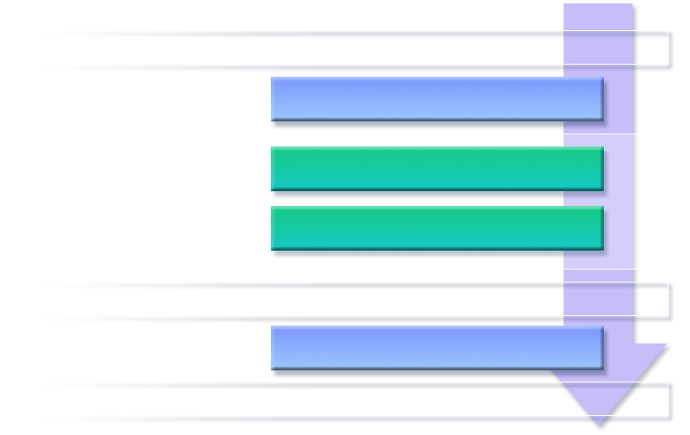
Page Event Life Cycle
Page is loaded, control hierarchy initialized
Page_Load
Textbox1_Changed
Control events
Button1_Click
1. Change Events
Control hierarchy is rendered
2. Action Events
Page_Unload
Page is disposed
05.<number>
Notes:
Module 05: Building ASP .NET Applications
Module 05.<number>
Copyright Microsoft 2001
July 15, 2001
Page Development
Page Event Life Cycle
When a user visits an ASPX page, it demands a particular cycle of event processing. It is important to understand that this event processing cycle occurs on the server between the time the user visits the page and the time the resulting HTML is sent to the browser. The event processing cycle implements an event processing system similar to Visual Basic.
When a page is requested and the controls are initialized, the Page_Load event fires. You can use the Page.IsPostBack property to determine when a Page_Load occurs during a post-back operation from a server control. Once the Page_Load occurs, the other events occur in the sequence shown on the slides.
Control action events
Button_Click
DataList_ItemCommand
Page_Unload
Fires at end of a request

Slide 13
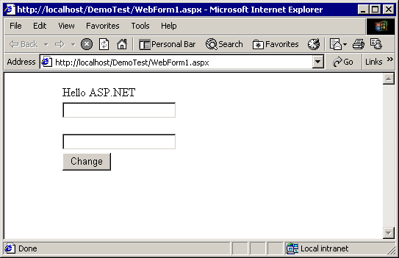
Demo
Web Forms 101
Show simple Web Form with server controls
Demonstrate page life cycle
05.<number>
Notes:
Module 05: Building ASP .NET Applications
Module 05.<number>
Copyright Microsoft 2001
July 15, 2001
Page Development
Demo
The purpose of this demo is to illustrate:
The ease of creating Web Forms
Power of server controls
Event paradigm of pages and controls
Standard HTML generation of controls
Show simple Web Forms with server controls and demonstrate the Page Event Life Cycle.

Slide 14


Slide 15
Questions
?

